Slide 1

CAREER HUB
CAREER SEEKERS

Slide 2
CAREER SEEKERS
NAME | ROLL NO. | ROLL | GROUP NO.
DEVANSHI | 2010991529 | JAVASCRIPT | 4
AARUSHI | 2010991435 | HTML | 4
ABHAY | 2010991441 | CSS | 4
AARZOO | 2010991437 | JQUERY | 4
CAREER SEEKERS

Slide 3
INTRODUCTION
TABLE OF CONTENTS
CODING MANIA
PICTO VIEW
WORKING
FUTURE SCOPE
CONCLUSION
CAREER SEEKERS

Slide 4
INTRODUCTION
A hub providing information about job opportunities in future for a graduate engineer. With the help of this ,we can recognize that which particular company is suitable for us. By wrapping our relevant experience ,ability to contribute and uniqueness in a whole ,we can identify our future goals and purpose.
CAREER SEEKERS

Slide 5
CODING MANIA
In this we have used html for the base of our webpage. For making it more attractive and creative we have used CSS (cascading style sheets).Also to make it user friendly or we can say interactive JavaScript is used. With the use of all these we made are webpage as best as we could. Hope you would like it…
CAREER SEEKERS

Slide 6


HOME PAGE
CAREER SEEKERS

Slide 7


CONTACT US
CAREER SEEKERS

Slide 8


ABOUT US
CAREER SEEKERS

Slide 9


STUDENT LOGIN PAGE
CAREER SEEKERS

Slide 10


ADMIN LOGIN PAGE
CAREER SEEKERS

Slide 11

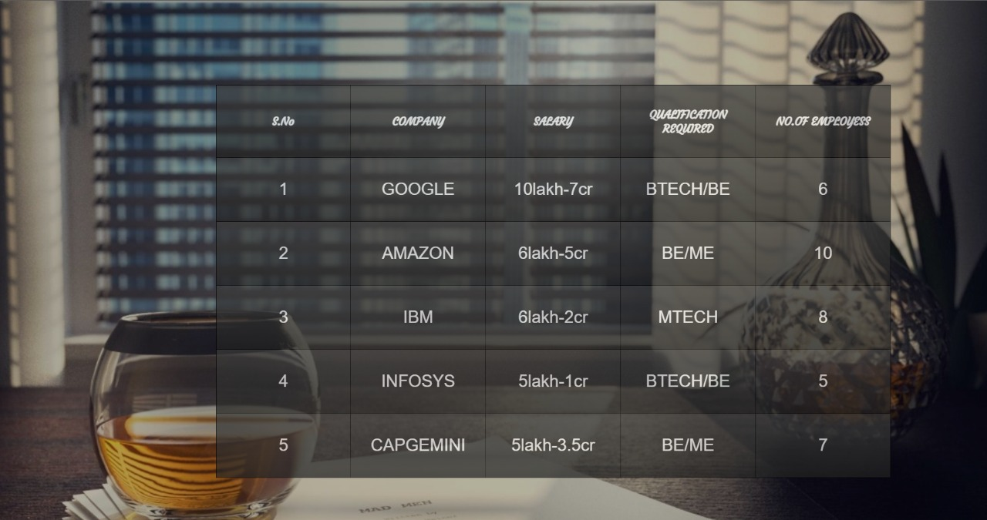
ABC DEF GHI
JKL MNO PQR
STU VWX YZ#*
TABULAR INFO ABOUT COMPANIES.....
CAREER SEEKERS

Slide 12



CAREER SEEKERS

Slide 13






CAREER SEEKERS

Slide 14



A
CAREER SEEKERS

Slide 15



CAREER SEEKERS

Slide 16



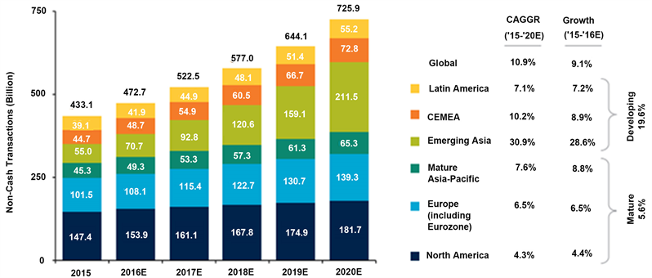
CAREER SEEKERS

Slide 17
WORKING
Let Our Advanced Worrying Become Advanced Thinking And Planning. So here goes the working of the project and the ways by which we have tried to make our project attractive. Firstly, if we would talk about our task bar on the very first page of our project there are three options namely- HOME, CONTACT US, ABOUT US.
CAREER SEEKERS

Slide 18
TO BE CONTINUED……………
. By words the meaning is very clear about their work, HOME is going to take you to the home page of our project, on clocking on CONTACT US you would be able to see our website and moreover if you have any query you should type and submit to us by clicking on the SEND button. if you click on the ABOUT US option you would be able to go through our webpages. Now coming down there are two buttons- ADMIN and STUDENT. If anyone wants to gain some best of their knowledge and built their future by having good placements they need to click on the suitable button- ADMIN or STUDENT and enter their username and password. there will be a respective login button by which on clicking it you will get into the page where your destination lies.
CAREER SEEKERS

Slide 19
TO BE CONTINUED……………
You will find a table having multiple columns- COMPANY NAME, STARTING SALARY, QUALIFICATION REQUIRED and some or the more columns. Now here comes the more interesting part. On clicking any of the company name you will be visiting on their page which would provide you some more knowledge with brief introduction. on the right hand side there are FLIP CARDS, on hovering over them they will turn up and provides you some expensive knowledge. By seeing the image of the flip card you will be able to guess the words which could be written inside it. So, how much seems to be interesting you will found it more by working through it. Now what are you waiting for...HURRY UP!! GO AND TRY IT OUT!!..Hope you would enjoy and gain best of your knowledge.
CAREER SEEKERS

Slide 20
FUTURE SCOPE
It is beneficial for the youth preparing themselves for IT department. As during the time of placements there is a lot of tension and confusion what to do and what not to. So our webpage makes it easy by guiding the aspirants what things to be focused for different companies.
CAREER SEEKERS

Slide 21
CONCLUSION
It concludes that you can get an appropriate knowledge about requirements and salary packages of a company which can help you to take right decision During preparation for your placements to get a well settled job. Here you can contact us for further queries also.
CAREER SEEKERS

Slide 22
CAREER HUB
THANKING YOU…..
THIS PROJECT IS A TEAMWORK OF
CAREER SEEKERS
DEVANSHI
ABHAY
AARUSHI
AARZOO
CAREER SEEKERS

